Slide 1

Junior Developer Intern Experience
Punyaja Mishra

Slide 2

Agenda
Introduction
About InnovFin
Plan
Blockchain
Improving success rate
Web Dev
Smart Contract
Smart Contract Implementation
Summary

Slide 3


Introduction
I spent 4 months at InnovFin Consulting Inc doing internship dealing with advanced growing technology like Blockchain, Artificial Intelligence, Augmented Reality and Virtual Reality.
The first meeting after getting hired I was told that my work will focus on Blockchain development of the site.

Slide 4

About InnovFin
Introduction

Slide 5
InnovFin Consulting Inc
InnovFin Consulting Inc is an educational platform that provide services and education on the growing tech like blockchain, AR, VR and AI. With upcoming platforms and services, InnovFin aims to provide knowledge about blockchain to people on blockchain, AI, AR, VR itself, to give a hands-on experience to the users.

Slide 6

Ultimate goal
Create an adaptable version of the certification system built on blockchain that provides users with certificates as requested for their finished course or module.

Slide 7
Team

Slide 8

The way to get started is to quit talking and begin doing.
Walt Disney

Slide 9
Abstract of the plan
Blockchain
Perform Online research on Blockchain and learn about it.
Reports
Continue research and write reports on the findings. Make a decision on what blockchain type would be better for the website, what tools can be used for development of the platform
Feedback
Review the InnovEdu Edtec platform and provide feedback for the best UX to improve the platform. Identify few important answers to the questions for the blockchain platform.
Project mapping
Developing
Map the key events of the process of the certification system. Decide the architecture appropriate for the development and design a plan to bring the demo to MVP state.
Start developing! Create UI of the interface and then Create a smart contract and implement it.

Slide 10
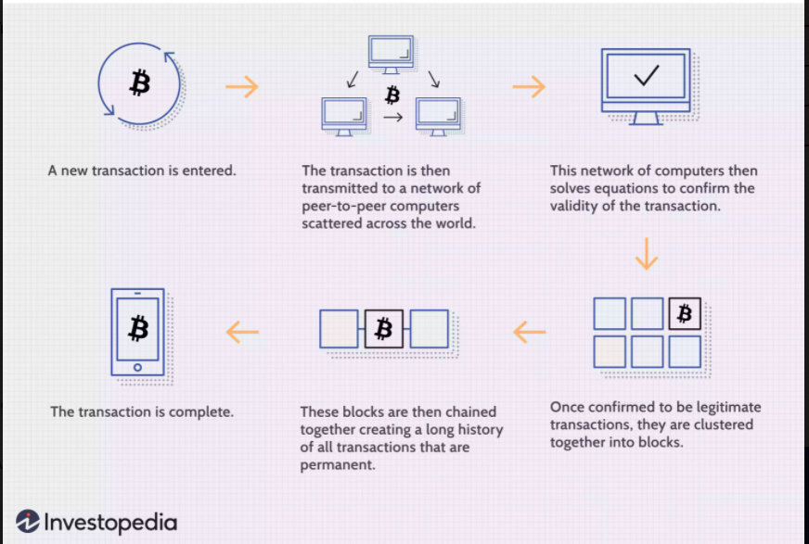
Blockchain
Decentralized Applications
Transparency
Security

Slide 11
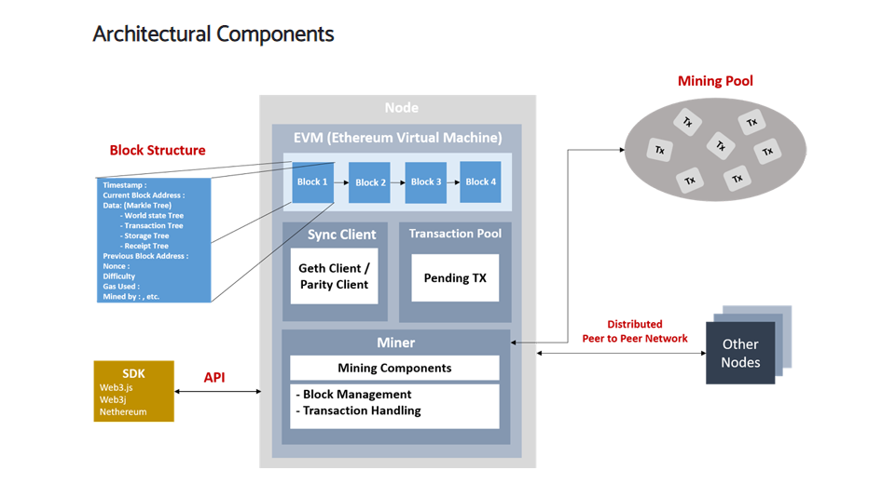
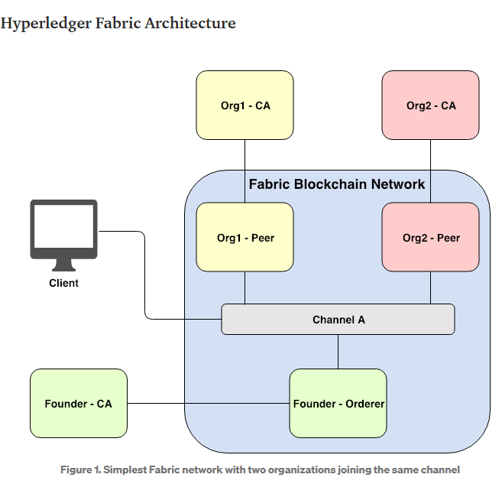
Ethereum vs Hyperledger

Slide 12
Developer Tools
Truffle
Ganache
Solidity
Golang
Mist
Docker
Remix IDE
There are various tools that a developer can use
Metamask

Slide 13

Improve success rate of a website

Slide 14
Steps to occur when a New user enters
New user enters
Use Cases with projected benefits
Identified Participants
Critical data to be exchanged
Any rules to be applied to the system
No metamask
owns a metamask
No automated step required
Automated metamask wallet created and applied
User is allowed to enter the system
On the network

Slide 15

Website Development
HTML, CSS for website designing
JavaScript for front-end development and functioning of the site
Solidity, Nodejs for backend development

Slide 16

Smart Contract
Rules to be applied on every transaction of the blockchain.

Slide 17

Problems
Errors on the same line of code according to the tool being used – Remix IDE and VS Code extension
No experience before
Not enough and adequately useful resources
Limited hours of work per week

Slide 18
Smart contract implementation
This has been the most difficult task among all the task I had in this internship
I did compile and had an error-free smart contract but unless I am able to get it working on the Ethereum network, it is not exactly useful or completed.
Tools and languages I was working with : Truffle, Ganache, Nodejs, JavaScript, terminal
Problems : error in the Truffle, in the truffle-config.js, not working ganache
The website was unable to connect to the network and hence the smart contract was also technically not connected or on the network. Therefore, no transaction was taking place and definitely no rules were being applied.

Slide 19

Was the goal reached?
Unfortunately, no.
I faced so many difficulties and obstructions towards the end and I was unable to get a working certification system by the end of my internship.
Lessons were learnt.

Slide 20




Summary
Learning a new topic online just reading and going through tutorials is not a bad idea but lack of practical knowledge and adequate time are big obstacles one can face. Overall, it was very educating and challenging internship with the ultimate goal not able to reach but a lot of contributions made to the company.

Slide 21

Thank you
Punyaja Mishra | punyajamishra@trentu.ca

